Slide 1



Cognitive Customer Engagement
CCE Chat Platform
Jan 2020
Anju Chopra

Slide 2



Cognitive Customer Engagement
C C E
CCE is an extensible software platform that imparts cognitive capabilities and intelligent automation to customer interaction and client’s business processes using multiple communication channels by seamlessly integrating client’s front and back office systems and business workflow.

Slide 3
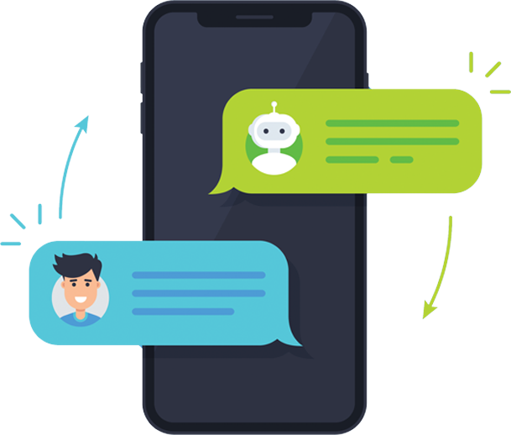
CCE Chat Platform
CCE Chat Platform provide a complete solution that allows users to communicate in real time using easily accessible web and mobile user interfaces.
The CCE Chat platform has a rich feature set and includes file sharing, message translation, and many more features. Designed to help entire organizations, teams, or individuals to communicate with one another in a group or one-to-one environment. It allows you to chat directly with your website visitors. Chatbot allows users to collaborate and communicate from wherever they are.

Slide 4
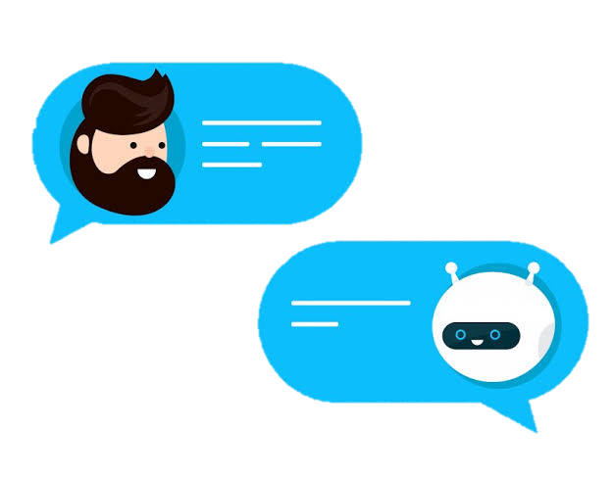
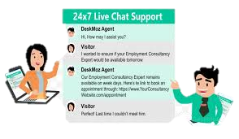

CCE Chat Platform
01
Customer to Bot Chat
CCE Chat Platform provides an Extensible and Scalable Chat Engine and Framework for following communication channels:
- Customer to Bot Chat
- Customer to Live Agent Chat
- Agent to Agent Chat
02
Customer to Live Agent Chat
03
Agent to Agent Chat /
Team Chat
4

Slide 5

CCE Chat Features
01
Live Chat / Messaging
LiveChat provide immediate customer support and information to clients and customers. Customer can chat with live agent to resolve their queries.
Enable Chatbot to answer your customer queries quickly and more faster, Accessible anytime, Personal Assistant, Cost Effective and many more.
02
Integration with Chatbot
Access the entire history of Chat interactions includes the contents of the chat and customer information. Also, have option to email chat transcript
03
Chat Transcripts / Interaction History
Automatic Message Translation / Multilingual
Automatic real-time message translation between users.
Our user interface has been translated to over 100 languages, more than any other team chat service.
04
CCE
Chat Platform
05
Offline Messages
Option to send offline message incase of unavailability of live chat agent.
Web, Desktop & Mobile support
Accessible from any device with internet access including Windows, Mac, and mobile or tablet devices using the iOS and Android native mobile apps
06
07
Hassle free Integration
Hassle free Integration with any client tools/application (CRM, Sales Force, Client website, Facebook messenger, WhatsApp, SMS)

Slide 6
CCE Chat Features
Option to choose particular department to resolve queries. Predefined Quick links / Q&A are available to select relevant queries. Also, have ability to check for additional questions relevant to previous response
08
Department / Quick Links
09
Welcome Message
Display Welcome message on chat widget based on location
Configure your business hours for the live chat agent / chat bot availability.
10
Business Hours
11
Knowledge Base(s)
Provide link to relevant articles, websites etc via Chatbot interface
CCE
Chat Platform
12
Team Chat
Send direct messages to any user, Team, post in Private Groups & Public Channels.
13
Customer Feedback / Survey
Option to get immediate feedback if answers provided are satisfactory. Also, can ask customer to conduct a Survey.
14
Automatic Notifications
Display Notification on new chat / message arrival

Slide 7
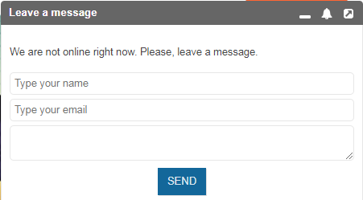
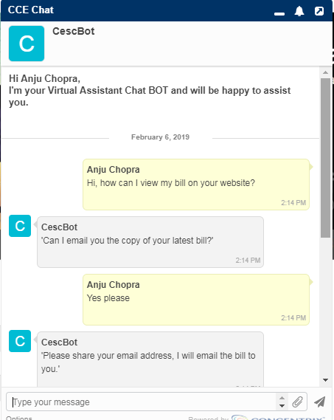
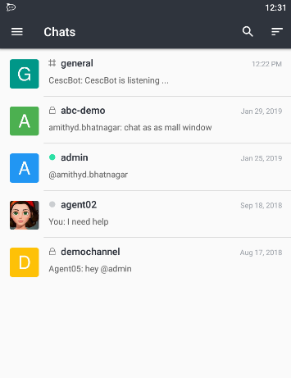
Chat Widget
Customer Chat with Chatbot
Agent Chat widget
Bot display Offline message if no Agent available

Slide 8
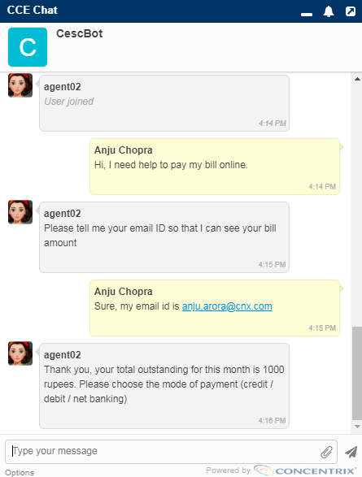
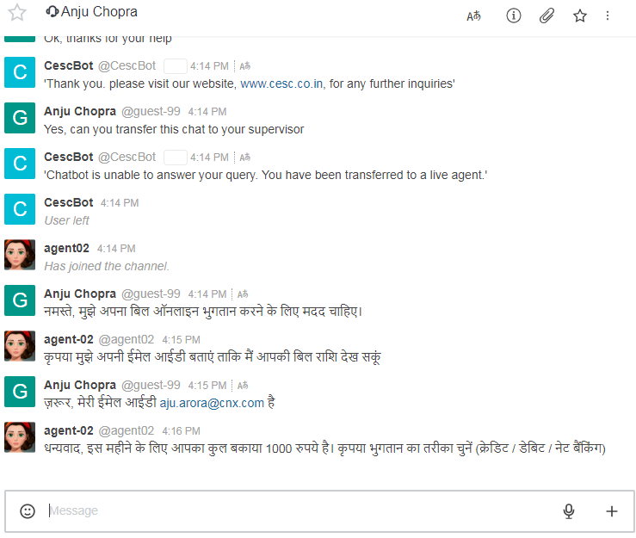
Chat Widget
Customer Chat widget
Agent Chat widget

Slide 9









CCE Chatbot Workflow
User Converses with Chatbot to request information
No
User Satisfied with response received from Chatbot
Yes
Customer
User Close Chat
CCE Platform
Chatbot Respond Real-time, perform actions and ask for more inputs
Yes
Request Analyzed by CCE Chatbot intelligence
Chatbot Understand Request
Chatbot Respond Real-time and Transfer chat to logged Agent
Chat received by Agent and Agent respond to User
No
Cognitive APIs
Intent and Entity Extraction from Chat Message
Tone Analysis of Messages and Display Chat History

Slide 10



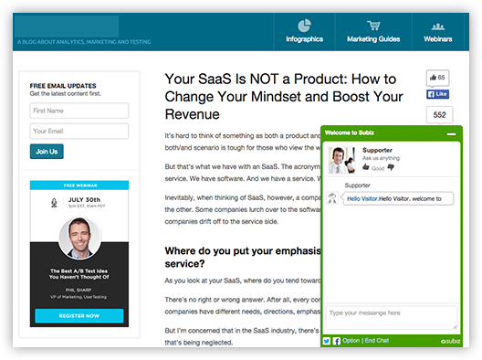








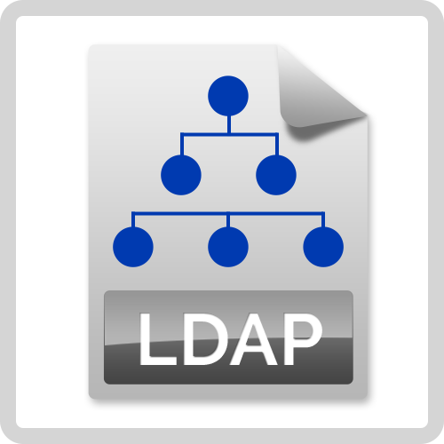




CCE Chat Platform - Framework
Customers
virtual private cloud
Internet
Agent VLAN
Web site + chat widget
Chat Server
Client’s Production Systems
VPN connection
Agent Chat & Admin Interface
Agents & Supervisors
VPN connection
Application Server
RDS
Web Server
CRM & Business Data
Internet
IBM Watson
Amazon
Lex

Slide 11
Cognitive Customer Security
Control Type | Measure | Applicable
Access Control | Each user can login to the system using their unique username and password | Yes
 | Credentials are transmitted via HTTPS for authentication | Yes
 | A temporary token is generated which stays valid for 30 minutes | Yes
 | Token based authentication is used for APIs without disclosing personal information identifier | Yes
 | Integration with Concentrix Active Directory/SSO requires user to authenticate with their AD/SSO credentials | Yes
 | Access to features and functionality is restricted based on user's role (agent, supervisor, etc.) | Yes
 | Access can be automatically revoked for user who leave organization or OU | Yes
 | Limited access to IT support staff is provided for application support | Yes
 | No access to production systems is provided to development team | Yes
 | Source code is stored in secured repository with role based access | Yes
Data & Code Security | Specific sensitive information database fields can be encrypted in the database (AES) | Yes
 | Sensitive data entities can be identified & masked before sending to external cloud services | Yes
 | Client data is logically separated into difference databases | Yes
 | Data purge policy can be applied to keep 90 days days or based on specific client needs | Yes
 | Non-production and production environments are separated physically at database level | Yes
 | All data inputs to application are validated | Yes
 | Risk of processing failures leading to loss of data integrity is minimized by transactions | Yes
 | The application and data are hosted on secured AWS cloud infrastructure in Mumbai region | Yes
Monitoring | Detailed OS and application level logging is available | Yes
 | Logging at network devices is done | Yes
 | Activities by admin are logged and protected | Yes
 | Audit trail is maintained for all operations | Yes
 | Organizational Change management process is followed for all changes | Yes
 | Version control is done and all changes are tracked and reviewed | Yes
Network Security | Firewall rules and tunnels to restrict access to specified user VLAN are in place | Yes
 | Network configuration that includes zoned security layering that is enforced by mandatory firewall and router rule sets | Yes
 | IP whitelisting for specific user/groups. Users will be allowed access from specific VLAN only | Yes
Intrusion Detection/Prevention | Regular vulnerability Scans and rectification steps are done | Yes
 | Application of security patches regularly | Yes
 | Activity logs are reviewed regularly | Yes
 | Cloud application security is taken care by our cloud infrastructure and API providers i.e. AWS, where strict monitoring and auditing of Applications are performed on regular intervals. For details, kindly refer the following: https://aws.amazon.com/security/ | Yes
Chat/KB Specific | Entities can be defined to mask sensitive information in chat history | Yes
 | Database field for chat history can be encrypted based on client requirement | Yes
 | Only supervisor and not the trainee can see the chat history after chat session is over | Yes

Slide 12



Leading American life insurance Company
Case Study: Cognitive Automation of Customer Chat Support Process
Business Challenges
Concentrix Solution
Results
High volume calls and concerns over increase in AHT, Customers hassled with registration and security process before getting to their request.
Emphasis on reducing AHT to meet client’s expectations caused error rates to rise.
Client wanted to route more volumes by expanding the contact center, however, did not want to incur higher costs in order to do so.
Concentrix designed and implemented a Chatbot to automate response using Cognitive Automation platform and automated all supporting activities like: Registration process, Billing & payment, Update policy & personal details and New policy loan.
The Cognitive AI solution enabled customer(s) to interact with a specialist (liveChat agent) to help them on real time bases and provide resolution post Bot interaction.
Depletion in calls, As most of the FCR are met either by ChatBot or LiveChat.
Reduction in Error rate well below target and, in fact, virtually eliminated.
Around 20-25% call volumes routed to chat bot & Livechat Agent with reduction of staff or cost.
Concentrix Cognitive Automation Implementation

Slide 13
Concentrix Human resources team
Case Study: Cognitive Automation: HR Knowledge Bot
Business Challenges
Concentrix Solution
Results
Accessibility/Visibility to raise a concern/issue/getting information was a long process for the employees.
Lack of unified platform to raise and receive employee quires.
“Be made to wait” to respond to the incoming Queries.
Large number of manual checkpoints and validations, multiple apps / screens etc leading to errors and escalations which is also resulting in increased rework
Concentrix deployed an integrated automation based on business data to respond quickly to employee’s grievance
The Cognitive AI solution integrated chatbot within Concentrix’s Enterprise Mobile App and its accessible to respond to employee queries anytime.
The Cognitive Automation chatbot is configurable to multiple queries related to different departments
Turnaround time to respond to a query reduced from 1-2 days to less than a Minute.
Reduced Manuel intervention.
Deploy across the organization
Lessen HR & Operational Workload
Concentrix Cognitive Automation Implementation

Slide 14
Concentrix Payroll Team
Case Study: Cognitive Automation: Payroll Knowledge Bot
Business Challenges
Concentrix Solution
Results
Unanswered queries of employees about their payroll leading to dissatisfaction
Lack of Bandwidth to support on numerous payment and investment issues during a month end or financial year ending.
Agents providing customer support on email had to access multiple systems and follow a complex case research involving process deviations and missed steps
We automated employee information retrieving process and structuring the Chatbot to automate response using Cognitive Automation platform
Concentrix deployed an Cognitive AI solution to save agents time from redundant activities across multiple legacy screens like Ramco, Ebucks and etc.
Reduced cost per contact, A small change in Employees Payroll policies can keep the finance team really busy.
Simplified process with the flexibility of customizing generated replies for more focused outputs
Reduction of nearly 50% of the Queries. Which is responded or addressed by chatbot
Concentrix Cognitive Automation Implementation

Slide 15
Concentrix Transport Team
Case Study: Cognitive Automation: Transport Knowledge Bot
Business Challenges
Concentrix Solution
Results
Immense pressure from accounts/ODC to have Admin’s presence to address employee’s grievances
Bundle’s of email queries, emphasis on meeting the employee’s expectations and leading to escalations.
Manual and redundant nature of processes was contributing to higher than desired timeline and Tats
Deployed Cognitive AI solution to ensure BOT serves the employee(s) grievances flawlessly.
Concentrix designed chatbot using Cognitive automation platform to optimize and re-engineer the overall process to eliminate inefficiencies and redundancies
We automated employee information retrieving and are generating replies for Intents recognized through an AI engine
Drastic reduction in Email Queries.
Faster and Structured Workflow with minimal manual intervention leading to reliable and smooth employee journey
Efficiency gain of approximately 30% which can also manage volume spikes without a need for additional human intervention
Concentrix Cognitive Automation Implementation

Slide 16
An Indian online travel company
Case Study: Cognitive Automation – KBOT
Business Challenges
Concentrix Solution
Results
Complex process with frequent process updates, required agents to approach SME’s frequently for clarifications on live calls by putting customer on hold effecting AHT and Customer experience.
Increased error rate due to Lack of knowledge base.
Concentrix designed and deployed Knowledge BOT (Automated Chat Engine) to provide ready help to agent queries, thereby reducing agent hold/TT and dependency on SME, resulting in improved customer experience
Reduced AHT, Improved quality and Customer experience
Empowered agents
Reduced Manuel intervention as Little or no dependency on SME.
Deploy across two locations Ranchi & Kolkata.
Concentrix Cognitive Automation Implementation

Slide 17
Thank you……

